Slide 1
Data analytics presentation
Sarah Ahmad Lafee Alobeytha
24110331

Slide 2
Invoice Data Analytics: Descriptive, Predictive, and Prescriptive Analysis
Introduction
Modern organizations generate large volumes of invoice data that contain valuable financial and operational insights.
Analyzing invoice data helps organizations understand payment behavior, predict future outcomes, and make optimal operational decisions.
This project applies data analytics techniques to a large-scale invoice dataset containing over 500,000 records.
The analysis is divided into three main stages:
  Descriptive analytics to explore and summarize invoice data
  Predictive analytics to forecast expected payment amounts
  Prescriptive analytics to optimize invoice processing costs across multiple centers
Why Analytics Matters to Management
Supports data-driven decisions
Improves forecasting and planning
Optimizes cost and resource allocation
Reduces risk and uncertainty

Slide 3
Project Objectives
Explore invoice data using descriptive analytics
Predict expected payment amounts using multiple models
Optimize invoice processing costs using prescriptive analytics
The project follows the full analytics lifecycle: understanding the data, predicting outcomes, and optimizing decisions.

Slide 4
Activity 1: Descriptive Analytics
Frequency analysis :
CREDIT: 319,419 invoices (≈ 60%)
CASH: 212,638 invoices (≈ 40%)
Real Insight
The organization relies more heavily on credit-based transactions than cash.
This increases exposure to payment delays and credit risk, especially when combined with overdue invoices.
Decision Implication
Strengthen credit control policies.
Prioritize monitoring of credit invoices in predictive models.

Slide 5
From your contingency table
CREDIT is higher than CASH in:
  GENERAL_SALES
  INCOME
  SPECIAL_SALES (especially strong)
Real Insight
Regardless of invoice category, customers prefer credit payments.
High-value or special sales are more frequently paid using credit.
Decision Implication
Credit risk management should be applied across all invoice types, not just special cases.
Invoice category alone is not sufficient to predict payment method.
From central tendency
Mean ≈ 1620 JD
Median ≈ 1179 JD
Mode ≈ 378 JD
Real Insight
The mean is much higher than the median and mode.
This indicates a right-skewed distribution caused by high-value invoices.
Decision Implication
Using the mean alone would overestimate a “typical” invoice.
Median is a more reliable indicator for operational planning.

Slide 6
From percentiles
75% of invoices ≤ 2020 JD
90% ≤ 3263 JD
95% ≤ 3973 JD
Real Insight
Most invoices are relatively moderate in value.
A small top percentage contributes disproportionately to revenue.
Decision Implication
High-value invoices should be prioritized for : Validation, Monitoring, Predictive accuracy
From dispersion
Standard deviation ≈ 2928 JD
Range ≈ 109,152 JD
IQR ≈ 1385 JD
Real Insight
Invoice values vary widely.
Extreme values significantly affect overall statistics.
Decision Implication
One-size-fits-all processing is inefficient.
High-value invoices require stricter controls than low-value ones.

Slide 7
Activity 1: Visualizations
Data Visualization
Bar and column charts
Pie charts
Boxplots
Scatter : Strong positive relationship between delay and invoice value, High-value invoices are more likely to be overdue, Financial risk is concentrated in a small number of cases, Days overdue is a critical predictive feature
and violin plots: Similar value distributions across payment methods, Most invoices are low to medium value, High-value invoices exist for both cash and credit, Credit payments show slightly higher variability
and bubble charts: Tax amount strongly correlates with expected payment amount, Discounts are concentrated on high-value invoices, Larger invoices receive larger discounts, Low-value invoices show minimal discount impact
Line chart : Daily expected payment amounts are highly volatile, High-value days occur regularly, No clear long-term trend at daily granularity, Data is stable across years
and area charts : Monthly revenue is stable over time, Aggregation reduces volatility, No strong seasonal patterns detected

Slide 8
Evaluating the Importance of Data Analytical Techniques in Decision-Making
Data analytical techniques play a critical role in transforming raw transactional data into actionable insights that guide organizational decision-making. In this project, descriptive, predictive, forecasting, and prescriptive analytics were applied to support evidence-based decisions within invoice processing operations.
Descriptive analytics provided visibility into invoice distributions, payment behavior, and outliers, enabling managers to understand current performance and identify potential risks. Without this step, decisions would rely on assumptions rather than factual patterns.
Predictive analytics enabled accurate estimation of expected payment amounts by learning relationships between invoice attributes. By comparing multiple models, decision-makers can select forecasting approaches that balance accuracy and interpretability, improving financial planning and risk management.
Prescriptive analytics moved beyond prediction to determine the optimal course of action. Linear Programming and Genetic Algorithms identified the most cost-efficient allocation of invoices across processing centers while satisfying operational constraints. This directly guides operational decisions and resource allocation.

Slide 9
Activity 2 – Predictive Analytics Overview
Techniques applied: Feature selection, Statistical modeling ,Machine learning, Deep learning
Target variable: Expected Payment Amount
Data preprocessing: Encoding categorical variables, Scaling numerical features, Train/test split
importance of data analytical techniques
Enables proactive financial planning
Identifies high-risk and high-value invoices
Supports credit risk management
Reduces uncertainty in revenue forecasting

Slide 10
Feature Selection and Its Value
Feature selection reduces dimensionality
Improves model interpretability
Prevents overfitting
Enhances prediction accuracy
SelectKBest achieved its highest performance when a larger number of features was retained (R² ≈ 0.957 with k = 12), indicating that additional features contribute useful information to the prediction task. However, this approach increased model complexity and reduced interpretability, as many features were included without considering their combined influence.
In contrast, SelectFromModel achieved nearly equivalent performance (R² ≈ 0.954) using only three features. This method evaluates features in a multivariate context and selects those that contribute most significantly to the model’s predictive power. By retaining fewer but more informative features, SelectFromModel provided a more efficient and interpretable model with minimal loss in accuracy
Feature selection significantly impacts linear model performance.

Slide 11
Predictive Model Performance Comparison
Model | Feature Selection | MAE | RMSE | R²
Linear Regression | SelectKBest (k = 3) | 776.78 | 1052.96 | 0.868
Linear Regression | SelectFromModel (3 features) | 490.73 | 620.96 | 0.954
Linear Regression | SelectKBest (k = 12) | 468.89 | 600.88 | 0.957
Decision Tree Regressor | SelectFromModel (3 features) | 320.95 | 466.89 | 0.974
Neural Network (ANN) | SelectFromModel (3 features) | 321.46 | ~425–450* RMSE inferred from loss value (MSE ≈ 180,475) | 0.978

Slide 12
Interpretation & Comparison
Linear regression performs well when sufficient relevant features are included, but it remains limited in capturing complex relationships.
Decision trees are highly effective for invoice data due to feature interactions and non-linear patterns.
Deep learning provides the most accurate forecasts when large datasets are available, but model transparency is reduced.
Chosen Model: Decision Tree Regressor
Near-best predictive performance (R² ≈ 0.974)
Much better interpretability than neural networks
Lower computational cost
Suitable for operational and managerial decision-making

Slide 13
Strengths & Limitations Summary
Model | Strengths | Limitations | Decision value
Linear Regression | Simple, interpretable | Cannot model complex patterns | Provides clear baseline estimates for expected payment amounts
Decision Tree | Handles non-linearity, interpretable rules | Can overfit | Supports rule-based decisions and risk segmentation
Neural Network | Highest accuracy, captures complexity | Black-box, computational cost | Improves forecasting accuracy for complex financial behavior

Slide 14
Time Series Forecasting Using Moving Averages
Time series forecasting was performed using Simple Moving Average (SMA) and Exponential Moving Average (EMA) models. Monthly expected payment amounts were used to forecast future revenue by extrapolating historical patterns. SMA provides a stable forecast based on recent averages, while EMA emphasizes recent observations to produce a more responsive forecast. These models enable short-term revenue forecasting and support proactive financial planning.
Model | Strengths | Limitations
SMA | Simple, stable forecast | Slow to react to changes
EMA | Responsive to recent trends | More sensitive to noise

Slide 15
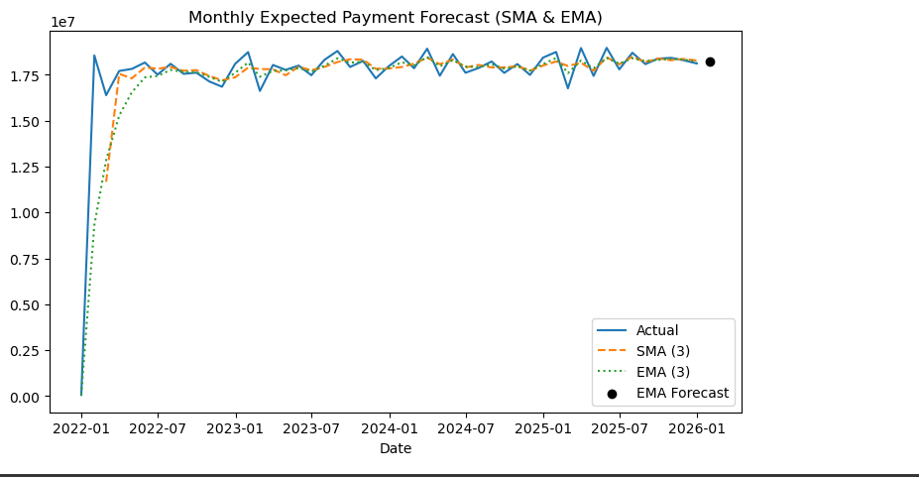
The monthly expected payment amounts show a relatively stable trend over time with moderate fluctuations. The EMA model closely follows recent changes and produces a forecast for the next month of approximately 1.8 million JD, indicating expected revenue stability in the short term. This forecast supports proactive financial planning and cash-flow management.
The forecasted payment value enables management to anticipate future cash inflows and plan operational and financial resources accordingly.

Slide 16
Prescriptive Analytics Analysis (Activity 3)
Prescriptive analytics enables organizations to move beyond prediction and directly determine the best course of action.
The prescriptive analytics task focuses on determining the optimal allocation of invoices across three processing centers (Amman, Irbid, Aqaba) in order to minimize total operational cost while satisfying capacity and accuracy constraints.
Two prescriptive analytic techniques were applied:
Linear Programming (LP)
Genetic Algorithm (GA)

Slide 17
Analysis of Linear Programming (LP)
LP is an exact optimization technique: it finds the best possible solution mathematically, while satisfying all constraints.
How LP operates in this context
Decision variables represent invoice quantities per center.
The objective function minimizes total processing cost.
Constraints ensure capacity limits and quality requirements are met.
Why LP is appropriate
The problem is linear and well-defined.
All constraints can be mathematically expressed.
LP guarantees the lowest possible cost.
Decision outcome
LP provides a clear, optimal allocation plan.
Management can confidently implement the solution knowing it is cost-minimal.
Analytical insight
LP is highly effective when the problem structure is clear, stable, and mathematically expressible.

Slide 18
Analysis of Genetic Algorithm (GA)
The Genetic Algorithm is a heuristic prescriptive technique inspired by natural evolution and is suitable for complex or large-scale problems.
How GA operates in this context
Each individual represents a possible invoice allocation.
A fitness function evaluates total cost.
Genetic operations (selection, crossover, mutation) evolve solutions.
A repair function enforces feasibility.
Why GA is appropriate
Does not require strict mathematical assumptions.
Can handle constraints flexibly.
Suitable for scenarios where exact optimization may be difficult.
Decision outcome
GA converges toward a near-optimal solution.
Results closely match the LP solution, validating its effectiveness.
Analytical insight
GA provides flexibility and robustness, especially for complex decision environments.

Slide 19
GA Convergence and Evolution Analysis
The convergence curve shows steady reduction in cost across generations.
Early generations explore many solutions.
Later generations refine high-quality solutions.
Stabilization indicates convergence to an optimal or near-optimal solution.
This demonstrates how prescriptive analytics iteratively improves decision quality.
LP guarantees the optimal solution under linear assumptions, while GA provides flexibility and robustness when constraints or cost structures become complex
Technique | Strengths | Limitations | Decision Value
Linear Programming | Exact, optimal, fast | Requires linear structure | Precise operational planning
Genetic Algorithm | Flexible, robust | Approximate solution | Adaptable decision-making

Slide 20
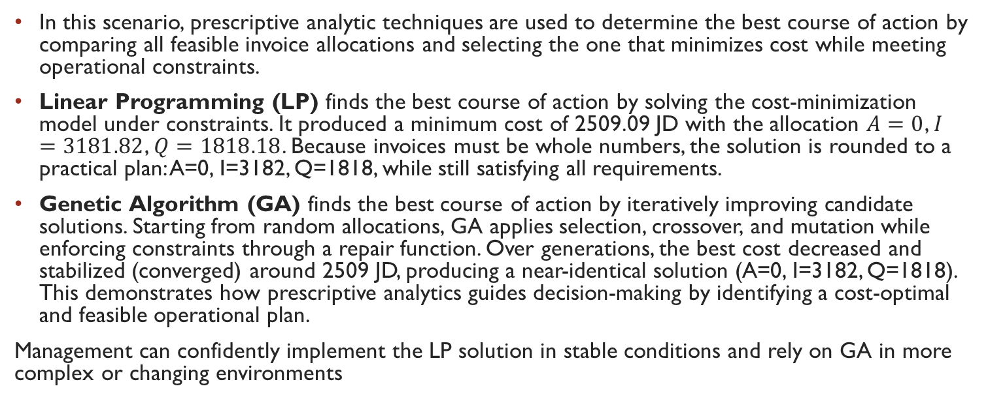
Using Prescriptive Analytics to Find the Best Course of Action
In this scenario, prescriptive analytic techniques are used to determine the best course of action by comparing all feasible invoice allocations and selecting the one that minimizes cost while meeting operational constraints.
Linear Programming (LP) finds the best course of action by solving the cost-minimization model under constraints. It produced a minimum cost of 2509.09 JD with the allocation $A=0$, $I=3181.82$, $Q=1818.18$. Because invoices must be whole numbers, the solution is rounded to a practical plan: A=0, I=3182, Q=1818, while still satisfying all requirements.
Genetic Algorithm (GA) finds the best course of action by iteratively improving candidate solutions. Starting from random allocations, GA applies selection, crossover, and mutation while enforcing constraints through a repair function. Over generations, the best cost decreased and stabilized (converged) around 2509 JD, producing a near-identical solution (A=0, I=3182, Q=1818). This demonstrates how prescriptive analytics guides decision-making by identifying a cost-optimal and feasible operational plan.
Management can confidently implement the LP solution in stable conditions and rely on GA in more complex or changing environments

Slide 21
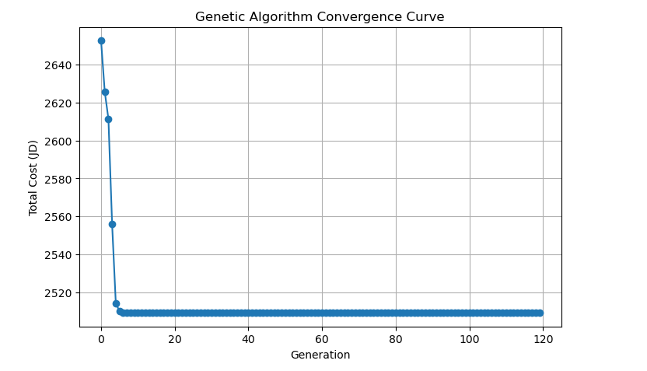
convergence curve shows:
Big cost improvement in early generations (fast learning)
Then the curve becomes flat around ~2509 JD
This means the GA converged (stopped improving), indicating it reached a stable near-optimal solution
What it proves:
The population evolved from random allocations to an efficient cost-minimizing allocation through selection, crossover, and mutation.

Slide 22
Thank you

